Slide 1

6
Resource Utilization

Slide 2
Chapter Concepts
Taking resource constraints into account when developing a network diagram
Determining the resource requirements plan for a project
Leveling the use of resources within the required time frame of the project
Determining the shortest project schedule with the limited resources available

Slide 3
Learning Outcomes
Create a network diagram that takes resource constraints into account
Prepare a resource requirements plan
Explain resource leveling
Discuss resource-limited scheduling

Slide 4
Project Resource Management
Project Schedule Management
Project Management Knowledge Areas from PMBOK® Guide

Slide 5
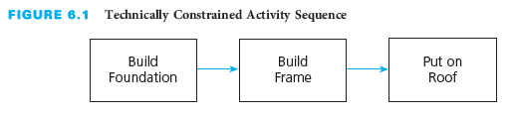
Technical-Constrained Planning
Serial relationship – performed in that sequence

Slide 6
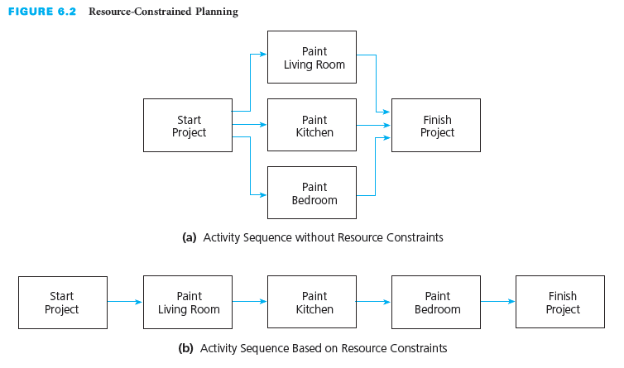
Resource-Constrained Planning
Available resources allow for concurrent tasks
Limited resource availability constrains project

Slide 7
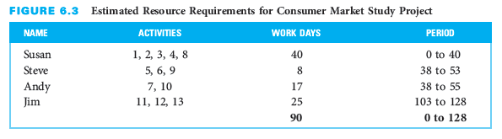
Resource Requirements Plan
Illustrates the expected resource use by time period
Indicate the amounts and types of resources needed to perform each activity

Slide 8
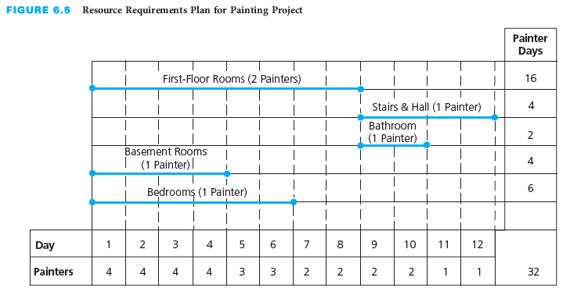
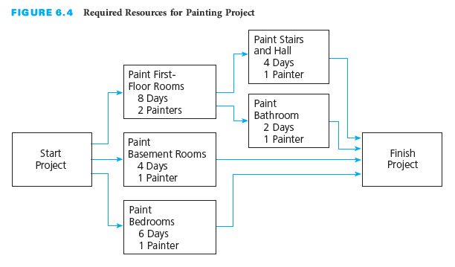
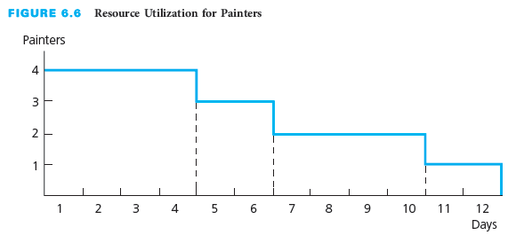
Example Painting Project: Resource Requirements

Slide 9
Resource Leveling
Minimize resource requirement fluctuations
Resources applied as uniformly as possible
Attempt to keep project schedule within required time
Delay start of noncritical activities
Use positive slack
Project management information systems assist
If delay beyond slack and on critical path, project will be delayed beyond required completion time

Slide 10
Resource-Limited Scheduling
Develop shortest schedule
Not exceed fixed available resources
Extend the project completion time if necessary
Give activities with the least slack first priority
Delay lower priority activities

Slide 11
Resource-Constrained Planning
Available resources allow for concurrent tasks
Limited resource availability constrains project

Slide 12
Resource Requirements Plan
Illustrates the expected resource use by time period
Indicate the amounts and types of resources needed to perform each activity

Slide 13
Example Painting Project: Resource Requirements

Slide 14
Resource Leveling
Minimize resource requirement fluctuations
Resources applied as uniformly as possible
Attempt to keep project schedule within required time
Delay start of noncritical activities
Use positive slack
Project management information systems assist
If delay beyond slack and on critical path, project will be delayed beyond required completion time

Slide 15

How to level the painting project?
Student Discussion

Slide 16
Resource-Limited Scheduling
Develop shortest schedule
Not exceed fixed available resources
Extend the project completion time if necessary
Give activities with the least slack first priority
Delay lower priority activities

Slide 17
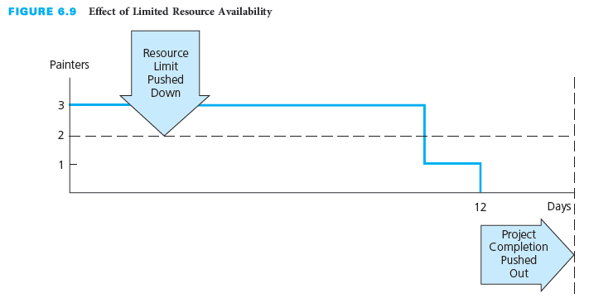
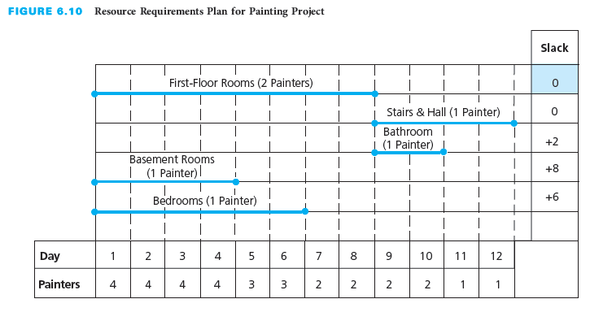
Example Painting Project: Limited Resources
Limit of two painters

Slide 18
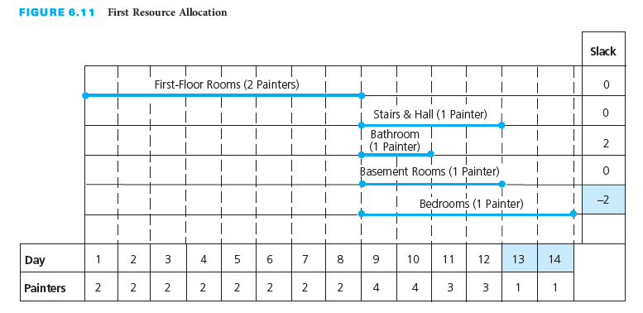
Example Painting Project: First Resource Allocation
“First Floor Rooms” has a slack of 0
Other tasks are delayed

Slide 19
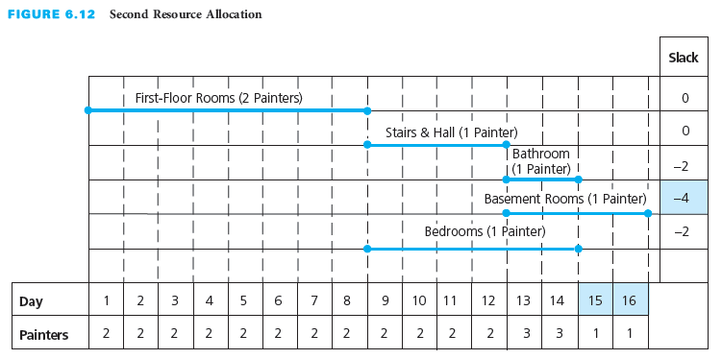
Example Painting Project: Second Resource Allocation
Begin “Stairs & Hall” and “Bedrooms”
Need to address limit for days 13 and 14

Slide 20
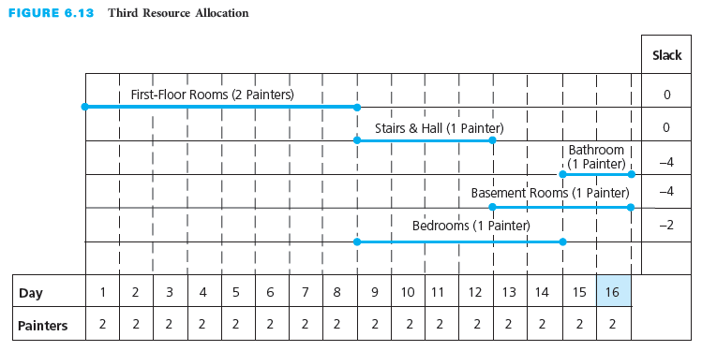
Example Painting Project: Third Resource Allocation
Delay “Bathroom” to days 15 and 16
Project delayed by 4 days

Slide 21
Resource Requirements For Information Systems Development
Five basic required resources
  People, hardware, software, data, and network resources
The more accurate the resource assessment, the more likely the project can be completed on time
Most common problem – Overallocation
  Resources assigned to multiple tasks at same time
  Conflict results in lengthening the time

Slide 22
Project Management Information Systems
Handle resource considerations within a project
Create and maintain a list of resources
Store availability, rate, and costs for resources
Assign resources and calculate cost
Assign calendar to record availability
Resolve overallocations for best solution

Slide 23
Critical Success Factors
Resources can constrain the project schedule because the quantities of various types of resources available to perform the project activities may be limited.
It is necessary to estimate the types and quantities of resources required to perform each activity.
If sufficient resources are not available when required, some activities may have to be delayed until a later time when resources become available to perform the activities.
Resource leveling, or smoothing, is a method for developing a schedule that attempts to minimize the fluctuations in requirements for resources. It levels the resources so that they are applied as uniformly as possible without extending the project schedule beyond its required completion time.
Resource-limited scheduling is a method for developing the shortest schedule when the quantity of resources is fixed. It will extend the project completion time if necessary.

Slide 24
Summary
The consideration of resources adds another dimension to planning and scheduling; resources can constrain a project.
Resources can include people, materials, supplies, equipment, tools, facilities, and other crucial elements to a project.
A resource requirements plan illustrates the expected utilization of resources by time period during the time span of the project.
Resource leveling, or smoothing, is a method for developing a schedule that attempts to minimize the fluctuations in requirements for resources when the project completion time is fixed.
Resource-limited scheduling is a method for developing the shortest schedule when the quantity of available resources is fixed, and may extend the project completion time in order to keep within the resource limits.

